Slide 1
Kubernetes attack hands-on lab
SE Training 2020

Slide 2
WIFI SSID: CYBRLAB
PASSWORD: %3)z4<_(6ZSB

Slide 3
Kubernetes 101
Notes:
Overview and Functionality

Slide 4
Introduction

Slide 5
History
CGroups
Kubernetes
Limited
Isolation
Docker
2004
2006
2013
2014
Notes:
Kubernetes is heavily influenced by Google’s Borg system
Original Google code name was Project Seven for Star Trek
Released in 2015 when Google partnered with Linux foundation to form CNCF
Often called K8s which is a Numeronym
K[ubernete]s → K[8]s → K8s (pronounced “Kates”)
Kubernetes - Greek for helmsman or pilot

Slide 6
What’s Kubernetes?
Kubernetes is an open-source system for automating deployment, scaling, and management of containerized applications.
Notes:
Software evolution have changed over the time. This evolution has been moving from applications running on a dedicated server or a VM to applications split up in micro applications running on containers in order to improve the Software practices.
In parallel Systems and Tools have been also changing in order to help to manage this new container world and then is when the concept of container orchestrator come up.
One of the most important container orchestrator distributions out there is Kubernetes which is an open-source system for automating deployment, scaling and management of containerized applications.
In a simple words, Kubernetes is a system to manage containers.
I am sure that you heard nowadays about a buzzword:Cloud Native, and many of you are wondering the relation of Cloud Native with Kubernetes ...
--------
Extra notes:
Why pick Kubernetes?
Kubernetes has become the default choice for container orchestration
Cloud Native Computing Foundation (CNCF) formed of the top tech open sources foundation in the world has backed Kubernetes and it is the first CNCF graduated project
Google trends shows that it is the most popular searched container orchestrator
Has been based on 15 years of experience running production workloads at google

Slide 7
Goal
“Kubernetes was built to radically change the way that applications are built and deployed in the cloud. Fundamentally, it was designed to give developers more velocity, efficiency, and agility”

Slide 8
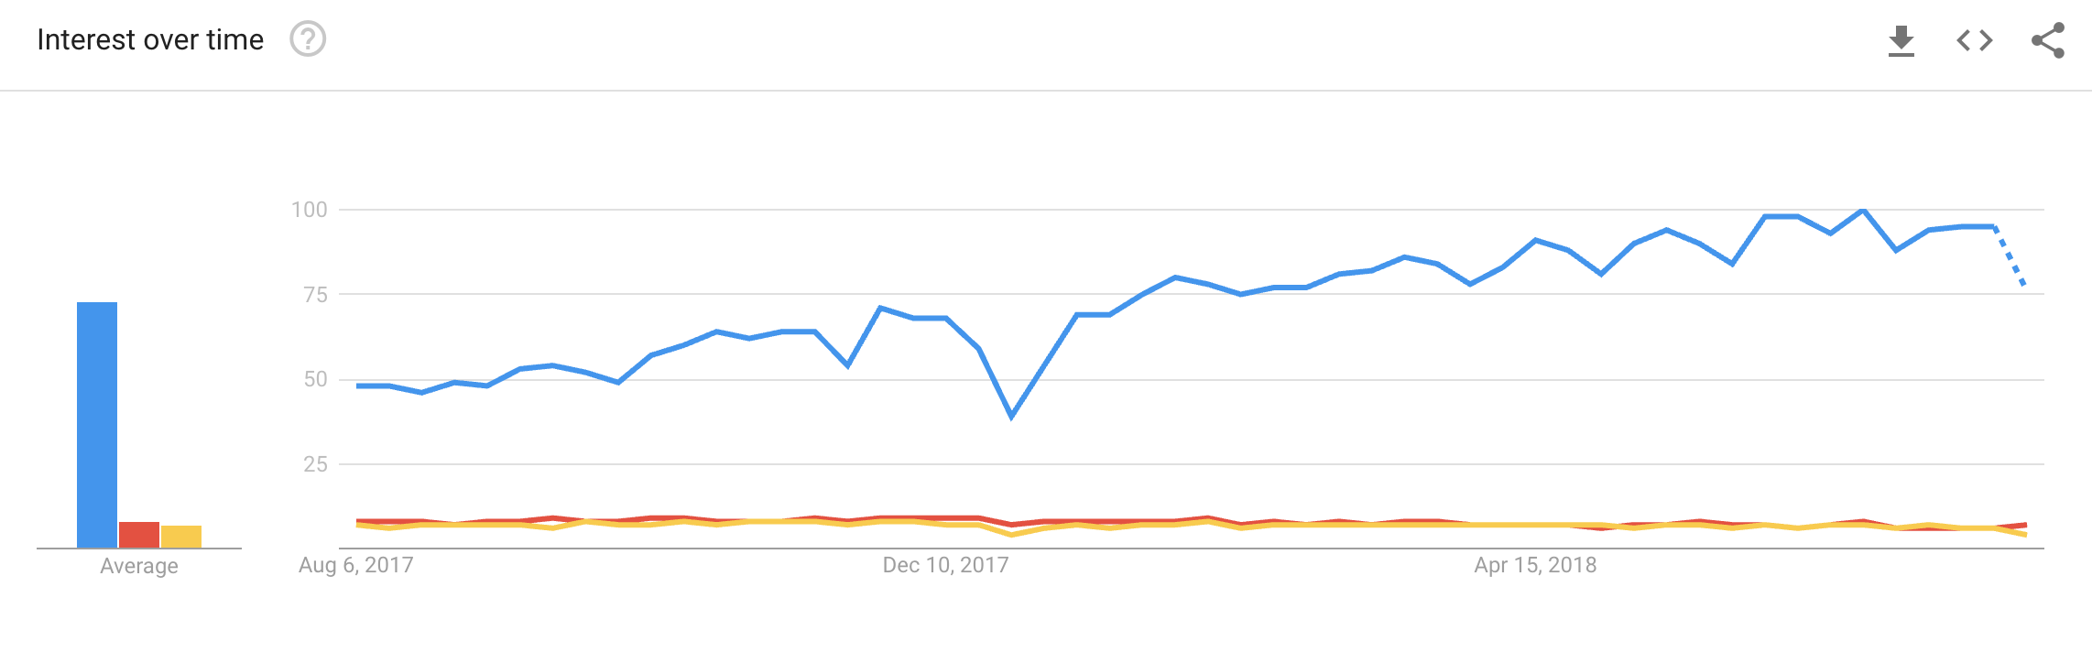
Trends
Kubernetes
Docker Swarm
Mesos
https://trends.google.com/trends/explore?geo=US&q=Kubernetes,Mesos,Docker%20swarm
Notes:
Kubernetes has become the default choice for container orchestration
Cloud Native Computing Foundation formed of the top tech companies in the world has backed Kubernetes and it is the first CNCF graduated project
Google trends shows that it is the most popular searched container orchestrator
Has been based on 15 years of experience running production workloads at google

Slide 9
Kubernetes Architecture

Slide 10
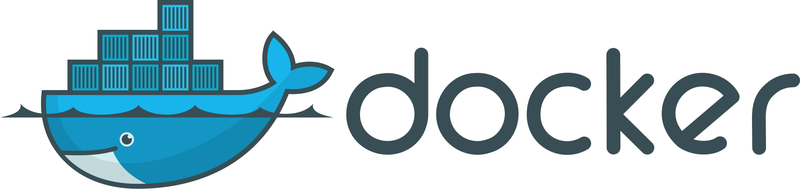



Container Runtime
Container Runtime
Libcontainer is runc
Linux Kernel features
Capabilities
Cgroups
Namespaces
Container Runtime
libcontainer
libvirt
lxc
systemd-nspawn
Linux
cgroups
namespaces
netlink
selinux
netfilter
capabilities
apparmor
Notes:
Container Runtime is wrapping runc(libcontainer) in order to create containers
Cgroup: Allow you to allocate resources such as CPU, Memory, Network bandwidth, disk bandwidth and so on among groups in order to create sub-systems.
Namespaces: It’s a kernel mechanism Limit what you can use and see. A process is associated with a namespace and can only see or use the resources associated with that namespace.E.g limit visibility to certain network interfaces, user IDs or filesystem mounts
Capabilities: They are privileges. E.g Change hostname

Slide 11
30,000ft view
User:
Kubectl (CLI tool)
UI: Dashboard
Master:
API Server
Etcd
Scheduler
Controller Manager
Nodes:
Kubelet
Container Runtime
Master
Node
Kubectl
API
Kubelet
Container Runtime
Controller manager
Node
Kubelet
Container Runtime
Scheduler
etcd
Notes:
That’s the idea we should keep in mind about Kubernetes Infrastructure. It’s the simplest one.
Basically we have three parts User, Master and Nodes
User: Kubectl is a CLI tool to communicate to kubernetes through the API
Node: Kubelet is the join point between Master and Node iis Kubelet
Master: Etcd is a key-value store where the cluster state is stored.
Master: Scheduler is binding pods to nodes. https://kubernetes.io/blog/2017/03/advanced-scheduling-in-kubernetes/
Master: Controller manager or Control Loops -
Master: Orchestrator is a container management tool
https://blog.heptio.com/core-kubernetes-jazz-improv-over-orchestration-a7903ea92ca

Slide 12
Master
API data store: Etcd (Cluster State)
Controller Manager :
Node Controller
Deployment Controller
ReplicaSet Controller
Replication Controller
Endpoints Controller
Service Account & Token Controller
..
Scheduler - Bind pod to Node
Well documented API https://kubernetes.io/docs/reference/
Uses OpenAPI and Swagger
Master Node
Kubectl
API
Controller manager
Scheduler
etcd
Notes:
Master is coordinating the cluster (orchestrator)
Master: ETCD is a key value store where the cluster state is stored.It can be in the same server than the master or can be hosted in other platform.
Master: Controller Manager are listening the API and modify/fill in/add
Node Controller- Responsible for noticing and responding when nodes do down
Replication Controller - Responsible for maintaining the correct numbers of pods for every replication controller
Deployment controller -
Endpoint Controller - Populates the Endpoints object (That is, joins Services and Pods )
Service Account &Token Controller - Create default accounts and API access tokens for new namespaces
Namespaces Controller -
https://kubernetes.io/docs/concepts/overview/components/
Master: Scheduler is biding pod to nodes.
Using OpenAPI from v1.10 and Swagger is deprecated and will be removed in v1.14.
https://kubernetes.io/docs/reference/api-overview/

Slide 13
Nodes
Worker Node/Minion
Kubelet:
cAdvisor (metrics, logs...)
Container Runtime:
Pod
Container (one or more)
Kube-proxy:
Used to reach
services and allow
communication between
Nodes.
Internet
Kubelet
Kube-proxy
CAdvisor
Pod
Registry
Container
Container
Runtime
Pod
Container
Container
Kernel
Notes:
Nodes are where we run applications
Linux Kernel Shared between containers.
Kubelet/cAdvisor - all K8s nodes have a kubelet that ensures that any pod assigned to it are running and configured in the desired state.
cAdvisor is a running daemon that collects, aggregates, processes, and exports information about running containers.
Kube-proxy:It is used to reach services. Kube-proxy pod running on each node listening for pod and services events to create some network rules that relates Services to different Backend pod. It can be setup in different ways (userspace, iptables, ipvs). Pod is a set of containers. Normally you want to put together the containers of an APP.

Slide 14
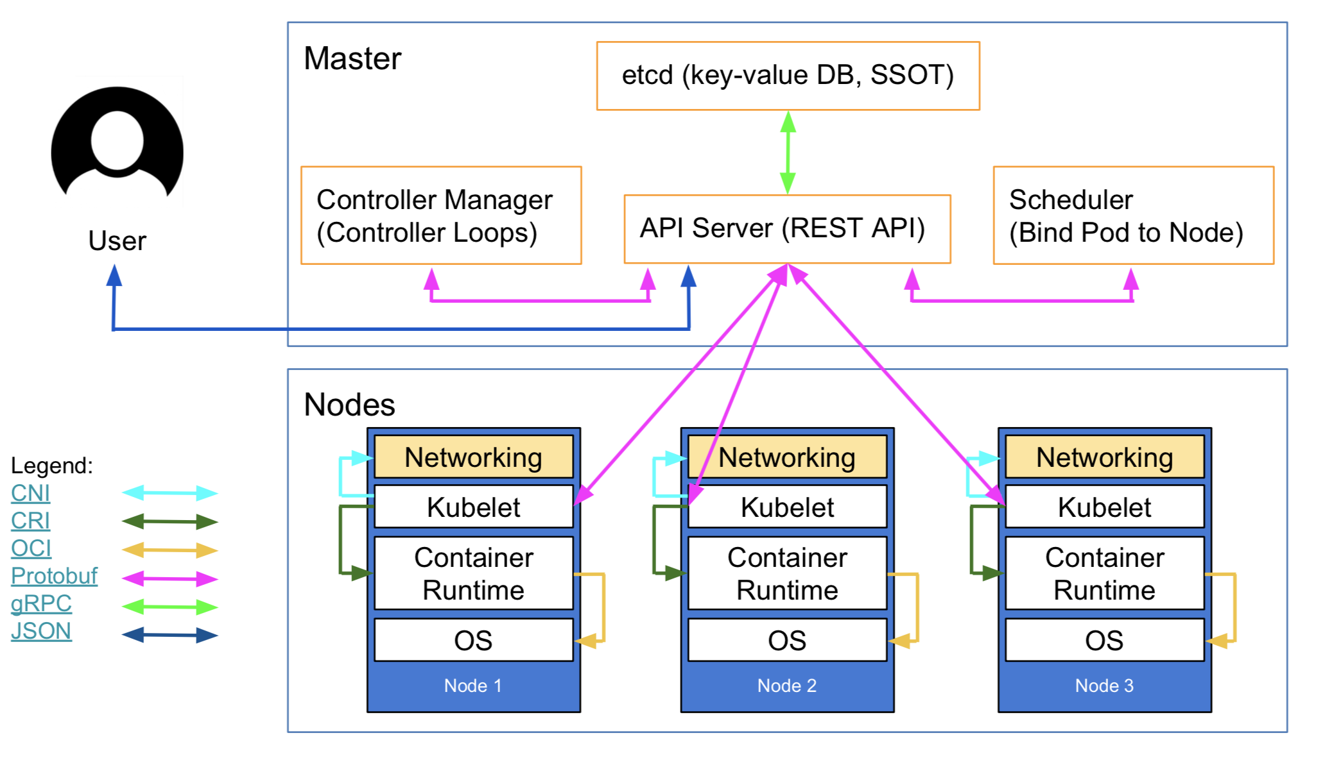
Communication
Notes:
CNI: Network Plugin in Kubelet that allows to talk to networking to get IPs for Pods and Services.
gRPC: API to communicate API Server to ETCD, Controller Manager and Scheduler
Kubelet - all K8s nodes have a kubelet that ensures that any pod assigned to it are running and configured in the desired state.
CRI(Container Runtine Interface) gRPC API compiled in kubelet which allows to kubelet to talk to container runtimes by using gRPC API.
The Container Runtime provider has to adapt it to CRI API to allow kubelet to talk to them by using OCI Standard (runc)
Initially, Kubernetes was built on top of Docker as the container runtime. Soon after, CoreOS announced the rkt container runtime and wanted Kubernetes to support it, as well. So, Kubernetes ended up supporting Docker and rkt, although this model wasn't very scalable in terms of adding new features or support for new container runtimes.
CRI consists of a protocol buffers and gRPC API, and libraries,

Slide 15

Reconcilation Loop
Reconciliation
Act
Observe
Current State
Diff
Current State = Desired State ?
Notes:
The underlying theory that Kubernetes runs on is quite simple.
In complex systems with a lot of moving parts it is easier to describe what state we want to be in, rather then the actions we need to take to reach the desired state. This makes Kubernetes configuration declarative and not imperative.
Current state is temporal and by the time you act upon the state it may have changed. So you need to continually evaluate current state. This makes Kubernetes evaluation an event loop.
So the Kubernetes is declarative configuration in an event loop otherwise known as a “reconciliation loop”.
Observe
Read - Retrieve the current state of resources
Read - Retrieve the desired state of resources
Diff
Resolve - What actions need to take place for current state resources to match desired state resources
Act
Create - Create a resource
Delete - Delete a resource
Update - Update a resource

Slide 16
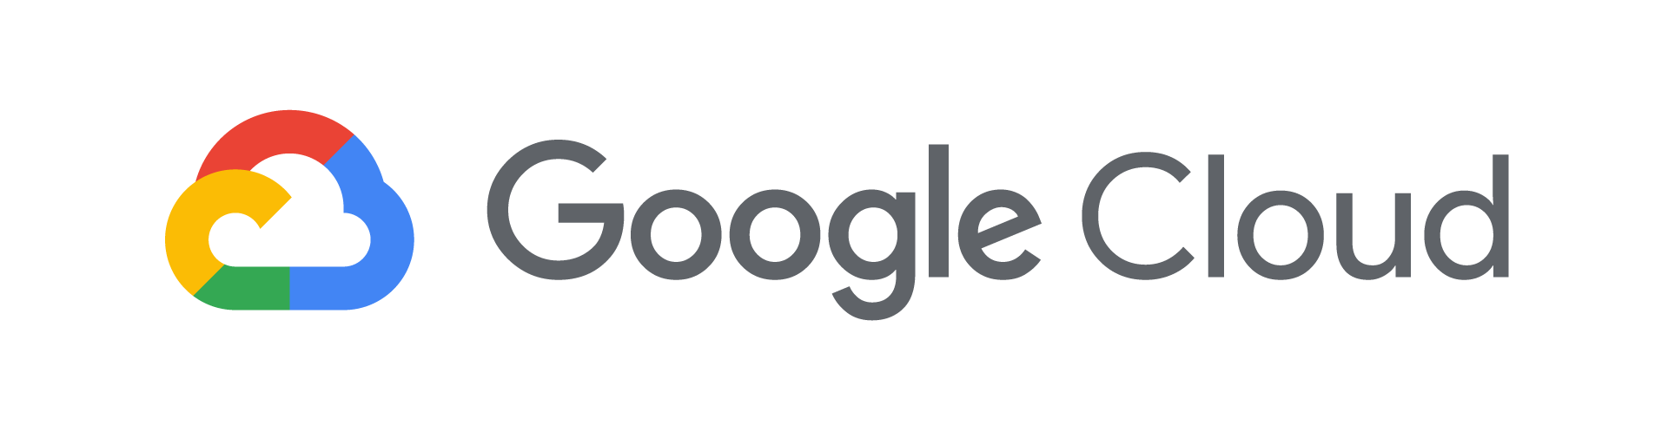
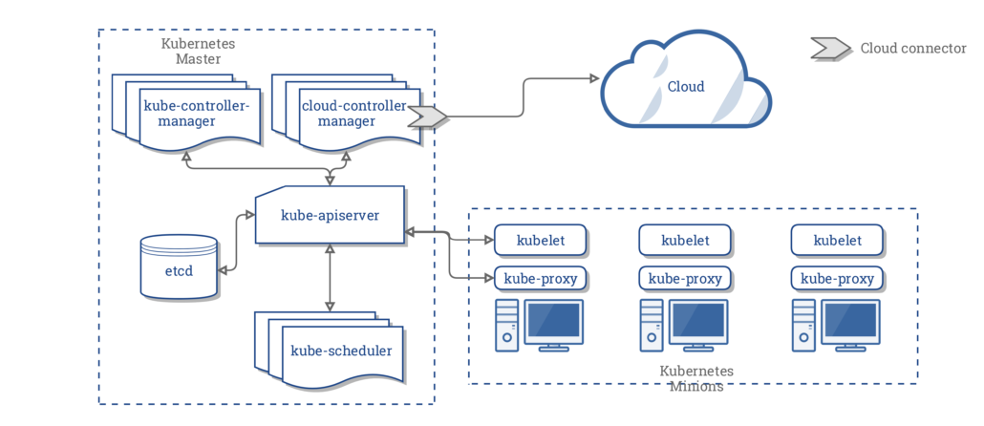
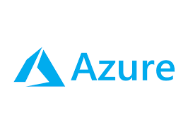

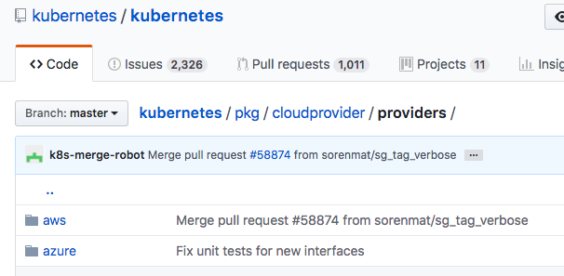
Run K8s for me
Just focus on Deployments:
Not maintain Master or Nodes
Cloud Controller Manager (CCM)
Code in Kubernetes Git repo:
X
X
Notes:
We can ask for running K8s for me to some cloud providers by using their Kubernetes managed services and focus just on deploy my apps on a robust and reliable Container Orchestrator.
Cloud Providers implement their own flavor of Controller Manager among others things
Cloud Providers code: https://github.com/kubernetes/kubernetes/tree/master/pkg/cloudprovider/providers

Slide 17
Kubernetes Concepts

Slide 18
Kubectl and Yml files
#Create/update resource
$Kubectl apply -f deployment-frontend.yaml
#List of pods
$Kubectl get pods
#Summary information about a pod
$Kubectl get pod myapp
#Detailed information about a pod
$Kubectl describe pods myapp
#Summary information about pod’s service
$Kubectl get service myapp-service
#Dump pod logs
$Kubectl logs myapp
#Get shell into running container
$Kubectl exec -it myapp-- /bin/bash
#Rollout new version of container for deployment
$Kubectl set image deployment/frontend myapp=image:v2
#Rollback to previous deployment
$Kubectl rollout undo deployment/frontend
#Scale the containers for deployment
$Kubectl scale --replicas=3 -f deployment-frontend.yaml
#Remove resource
$Kubectl delete -f deployment-frontend.yaml
YAML or JSON
apiVersion: v1
kind: Pod
metadata:
name: myapp
namespace:dev
labels:
app: myapp
annotations:
kubernetes.io/ingress.class: nginx
spec:
containers:
- name: myapp-container
image: busybox
Notes:
The most common way to interact with your Kubernetes API is to use Kubectl. Its a command line tool that allows you to specify the desired state for a Kubernetes resource in json or yaml format
Key components of a Kubernetes resource file:
apiVersion: Is the name for the API group being accessed. For non default groups its normally in the format of “group name/version”
kind: Type of resource being managed
metadata: Contains name of the resource, plus any other descriptive data
namespace: In a nutshell its environment segregation. IYou can isolate Pods and Services from each other by placing resource constraints and configuring RBAC. Kubernetes stores its own pods in the default namespace kube-system
labels: Labels can be used to select objects and to find collections of objects that satisfy certain conditions
annotations: Annotations can be used to pass extra information/configuration to humans, controllers and containers
spec: Defines all of the resource-specific attributes a

Slide 19
Pod
Pods
Labels
Namespaces( kube-system and default )
Volumes (empty, configmap, secrets...)
apiVersion: v1
kind: Pod
metadata:
name: myapp
namespace:dev
labels:
app: myapp
spec:
containers:
- name: myapp-container
image: busybox
command: ['sh', '-c', 'echo Hello Kubernetes! && sleep 3600']
volumeMounts:
- mountPath: /myvol
name: myvol
volumes:
- name: myvol
emptyDir: {}
Namespace: dev
Pod
Labels: [app: myapp]
Container
Name: sidecar
Image: proxy
Container
Name: myapp
Image: busybox
Vol
Notes:
A Pod is the smallest concept we have in kubernetes. But take note it is not a container. Pods can consist of one or more containers.
Pods deployed by default in kubernetes (kube-system namespace):
Dashboard
Kube-dns
kube-proxy
Volumes: Serves data to the containers.

Slide 20
Configmap and Secrets
Secrets
ConfigMaps
apiVersion: v1
kind: Secret
metadata:
name: mysecret
type: Opaque
data:
username: YWRtaW4=
password: MWYyZDFlMmU2N2Rm
apiVersion: v1
kind: ConfigMap
metadata:
name: special-config
data:
SPECIAL_LEVEL: very
SPECIAL_TYPE: charm
Namespace: dev
Vol
secret (file)
configmap (file)
Pod
Labels: [app: myapp]
Container
Name: myapp
Image: busybox
Env Var $secret
$configmap
Notes:
Configmap are used for any non sensitive configuration information that you want to share with a container.
Secret are used for any sensitive configuration information that you want to share with a container.
The configuration consists of a key and a value
Exposed as a file on a volume. It is common practice to place your entire configuration file as a value and expose it as a file on a volume.
Exposed as an environment variable
For secrets
The value is additionally Base64 encoded
It is important to note, that by default secrets are stored unencrypted in etcd unless you have enabled the encryption provider which was released with version 1.13

Slide 21
Deployments
Deployments
Scaling
Rolling
Strategies:
Recreate
RollingUpdate (default)
Blue/Green
Canary
A/B Testing
Deployment
apiVersion: apps/v1
kind: Deployment
metadata:
name: nginx-deployment
labels:
app: nginx
spec:
replicas: 2
selector:
matchLabels:
app: nginx
template:
metadata:
labels:
app: nginx
spec:
containers:
- name: nginx
image: nginx:1.7.9
ports:
- containerPort: 80
Replicaset1
Replicaset2
Pod1
Pod1
Pod 2
Pod 2
Notes:
Step 1 - Replicaset1 with 2 pods on version 1
Step 2 - Replicaset1 with 2 pods on version 1 and Replicaset2 with 2 pods on version 2
Step 3 - Replicaset2 with 2 pods on version 2
Deployments: A Deployment provides declarative updates for Pods and Replica Sets. You can define Deployments to create new resources, or replace existing ones by new ones. Deployments is giving us a rolling update functionality
For deploying stateless apps
ReplicatSet: ensures that a specified number of pod "replicas" are running at any one time. Ensures that launch the desired number of pods and keep the desired state.
ReplicaSet: don’t use directly, rather use Deployment
Strategies:
RollingUpdate(Default): Create a new replicatSet scaling down old pods and scaling ip new pods until desired state has been reached
Recreate: Terminate the old version and release the new one.
Blue/green: After testing the new version meets the requirements, we update the kubernetes Service.
MORE INFO: http://container-solutions.com/kubernetes-deployment-strategies/

Slide 22
Statefulset
Stable, unique network identifiers [0,N)
Stable, persistent storage/volume
Ordered, graceful deployment and scaling (0..N-1)
Ordered, graceful deletion and termination (N-1..0)
If persistence is required then select this instead of a Deployment
Notes:
StatefulSets is a controller that provides a unique identity to its Pods. It manages Pods that are based on an identical container spec and guarantees about the ordering and scaling. So if a pod becomes unresponsive and gets killed off, when a new one is created it will appear identical to the one before and have the same volumes used before
Stable, unique network identifiers.
Stable, persistent storage.
Ordered, graceful deployment and scaling.
Ordered, graceful deletion and termination.
In the above, stable is synonymous with persistence across Pod (re)schedulings. If an application doesn't require any stable identifiers or ordered deployment, deletion, or scaling, you should deploy your application with a controller that provides a set of stateless replicas. Controllers such as Deployment may be better suited to your stateless needs

Slide 23
DaemonSets
At least one pod running on each node
Master
Node
Node
Node
Pod1
Pod1
Pod1
Notes:
A Kubernetes Service is an abstraction which defines a logical set of Pods. You would use a service the same way you would use a load balancer to ensure high availability of a web server. You can even specify which type of session affinity to use. By default, the choice is round robin.
Kube-proxy creates network rules by listening for service events on the k8s api. It configures ip tables on each of the nodes.
https://kubernetes.io/docs/concepts/services-networking/service/#virtual-ips-and-service-proxies

Slide 24
Services
Client
API Server
Services Types
ClusterIP
NodePort
Load Balancer
Provide:
Find pods by label selector
Load Balancing
Service Discovery
kind: Service
apiVersion: v1
metadata:
name: my-service
spec:
type: LoadBalancer
selector:
app: MyApp
ports:
- protocol: TCP
port: 80
targetPort: 9376
Node
Kube-Proxy
Service
Backend Pod1
Backend Pod2
Backend Pod3
Notes:
Step 1 - 2 nodes, 2 pods
Step 2 - 3 nodes, 2 pods - a new node gets added to the k8s8 cluster
Step 3 - 3 nodes, 3 pods - DaemonSet will ensure that Pod1 is created on the new node
DaemonSets: Ensure that there’s at least one pod running on each node. Logging, security or monitoring agents.

Slide 25
Ingress Controller
Service
(Load Balancer)
Pod running on nodes
Service - Load balancer
Provides:
Load Balancer
Proxy Reverse
Join point:
Ingress object
Pod
(Ingress Controller)
Ingress
Ingress
Service
(NodePort)
Service
(NodePort)
Service
(NodePort)
Notes:
In Kubernetes you can create your own software routers for traffic. These software routers are called Ingress Controllers. They run as a pod.
You could for instance run something like Traefik which would allow you to setup a wildcard dns, then by using convention you could route traffic to svc-name.test.com.
Or you could configure an OAuth proxy to ensure that all requests have a valid JWT token.

Slide 26
Ingress
apiVersion: extensions/v1beta1
kind: Ingress
metadata:
name: test
spec:
rules:
- host: foo.bar.com
http:
paths:
- backend:
serviceName: s1
servicePort: 80
- host: bar.foo.com
http:
paths:
- backend:
serviceName: s2
servicePort: 80
myweb.com/blue
myweb.com/green
blue.myweb.com
green.myweb.com
Ingress Controller
Ingress Controller
Service Blue
Service Green
Service Blue
Service Green
Notes:
An ingress is used to configure an ingress controller to send traffic to a particular service.
In the example we are configuring traffic with a host header of foo.bar.com to be sent to a service called s1 and traffic with a host header of bar.foo.com to a service called s2.

Slide 27
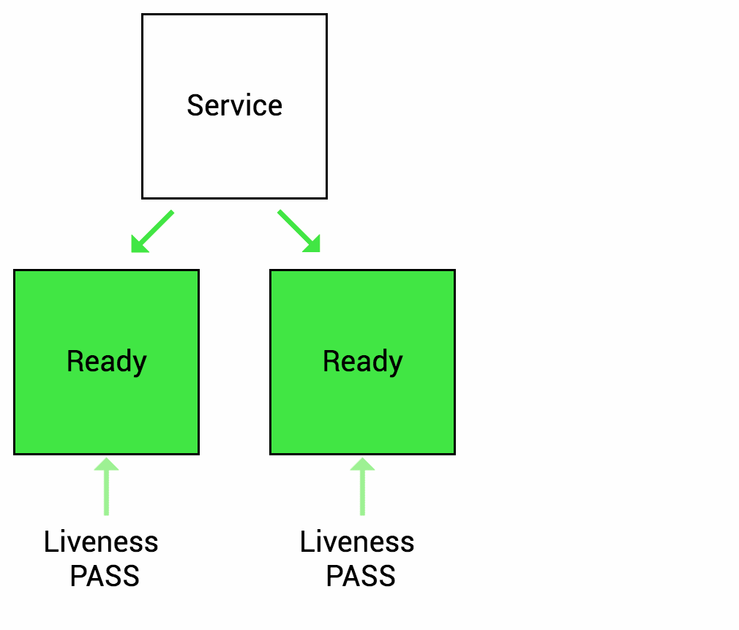
Health checks: Liveness Probe
Liveness probe
Command
TCP
HTTP
livenessProbe:
httpGet:
path: /healthz
port: 8080
httpHeaders:
- name: X-Custom-Header
value: Awesome
initialDelaySeconds: 3
periodSeconds: 3
Notes:
Liveness probe: Many applications running for long periods of time eventually transition to broken states, and cannot recover except by being restarted. Kubernetes provides liveness probes to detect and remedy such situations.
Configure within container spec.
Kubelet is carrying out the health checks
Customizable by intervals of times
Fix Deadlocks

Slide 28
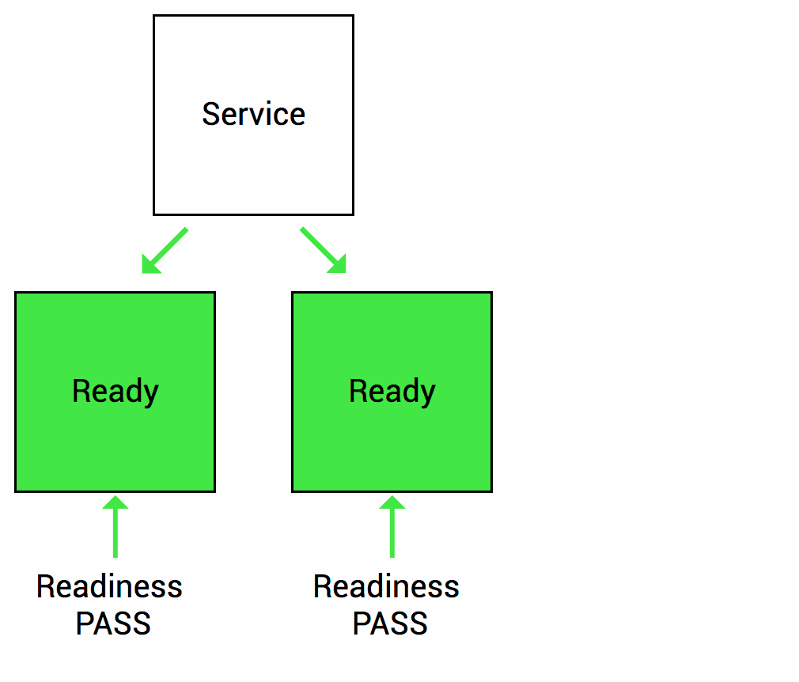
Health checks: Readiness Probe
Readiness probe
Command
TCP
HTTP
readinessProbe:
exec:
command:
- cat
- /tmp/healthy
initialDelaySeconds: 5
periodSeconds: 5
Notes:
Readiness probe: Sometimes, applications are temporarily unable to serve traffic. For example, an application might need to load large data or configuration files during startup. In such cases, you don’t want to kill the application, but you don’t want to send it requests either. Kubernetes provides readiness probes to detect and mitigate these situations. A pod with containers reporting that they are not ready does not receive traffic through Kubernetes Services.
Readiness probes are configured similarly to liveness probes. The only difference is that you use the readinessProbe field instead of the livenessProbe field.
Kubelet is carrying out the health checks
Customizable by intervals of times
Configure within container spec.

Slide 29
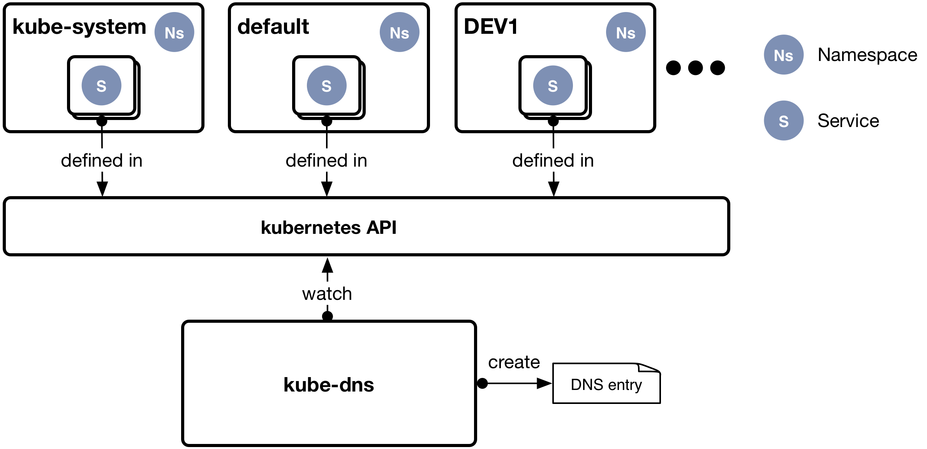
Service Discovery
Kube-dns: Pod running on nodes
Watching API for Pod and Services events
You can reach your deployments by the service name thanks to kube-dns
Default domain: cluster.local
my-svc.my-namespace.svc.cluster.local
pod-ip.my-namespace.pod.cluster.local
Notes:
Kube-dns has been replaced with CoreDns in newer version of Kubernetes.
For service discovery in Kubernetes there are a couple things you can make use of for service discovery. The easiest and most common usage is via dns. Refer to the dns entry for the svc endpoint and then traffic will automatically be routed to any live and ready pods.
For more advanced scenarios you could be listening to pod and service events and dynamically updating configuration in a configuration management database.

Slide 30
What ELSE?

Slide 31




What’s Next?
Helm: Package Manager for Kubernetes
Service Mesh: Istio - Layer for handling service-to-service communication.
Monitoring: Prometheus
Logging: EFK

Slide 32
References
Kubernetes
https://jvns.ca/blog/2016/10/10/what-even-is-a-container/
https://blog.heptio.com/core-kubernetes-jazz-improv-over-orchestration-a7903ea92ca
https://medium.com/jorgeacetozi/kubernetes-node-components-service-proxy-kubelet-and-cadvisor-dcc6928ef58c
https://github.com/contino/kubernetes-101
https://github.com/ramitsurana/awesome-kubernetes
Kubernetes Security: https://kubernetes.io/blog/2018/07/18/11-ways-not-to-get-hacked/
Helm:
https://www.aquasec.com/wiki/display/containers/Kubernetes+Helm+101
https://www.automox.com/blog/kubernetes-helm-101
CI/CD: https://thenewstack.io/ci-cd-with-kubernetes-tools-and-practices
Istio: https://blog.jayway.com/2018/10/22/understanding-istio-ingress-gateway-in-kubernetes/
Prometheus: https://resources.coreos.com/webinars/prometheus-101-webinar
Kubectl Exercices:
Kubernetes 101 - Katacoda:
https://www.katacoda.com/andresguisado
Security - Control Plane Katacoda:
https://control-plane.io/training
Istio - Katacoda:
https://www.katacoda.com/courses/istio
https://learn.openshift.com/servicemesh/

Slide 33
The primary attack vector

Slide 34
Misconfiguration
Over Permissioning
Shadow Admins
KubiScan

Slide 35
Attaaaaaack!!!!!

Slide 36
THANK YOU

